Slide 1

Vivekananda College of Engineering & Technology
password protected automobile ignition system
Name of guide:
Prof. Shivaprasad
Team members:
Name: USN:
Dhanya P 4VP20EC009
Kshema B S 4VP20EC015
Praseeda M 4VP20EC021
Umashankari 4VP20EC037

Slide 2
Introduction
Safety and security of vehicles has been one of the most pressing concerns today.
Ignition of automobiles with the help of a key can not provide the required protection.
As the name ‘Password Protected Automobile Ignition System’ says, here the idea is to introduce a system such that the initiation and ignition of an automobile engine is controlled by a switch and protected by a password entering system.
The purpose of this project is to provide strong security system and to make theft cases almost impossible.

Slide 3
Literature Survey
Existing Approaches:
Today it is common to see vehicle ignition using unique key structures.
There are bluetooth or wifi activated door lock systems.
Smart card interface with vehicle.
Proposed Approaches:
This project can be further modified by providing touchscreen facility.
It can be further modified by using GSM modem to alert the owner once the vehicle starts.

Slide 4
Block Diagram
Arduino UNO
Keypad
Motor Driver
(L293D)
DC Motor
Switch

Slide 5
Hardware & Software Requirements
Software used:
Arduino IDE.
Tinkercad online circuit simulation platform.
Components used:
Arduino UNO: An open source microcontroller board based on Microchip ATmega328P and is programmable with the Arduino IDE.
Keypad 4*3: 12 button keypad having 4 rows and 3 columns.
L293D: It is a typical 16 pin motor driver IC which can control DC motor.
DC Motor: It converts electrical energy into mechanical energy.
Slide switch.
Battery (9V).

Slide 6
Methodology
To start the motor:
Put the switch in to ON state.
Enter the password.
If the entered password is correct, one of the inputs to the motor driver becomes high.
It results in the rotation of motor in one direction.
Turn OFF the switch to stop the motor.
To change the password:
Keep the switch in OFF state.
Enter the password.
If the entered password is correct, option to change the password is enabled.
The purpose is achieved by programming.

Slide 7
START
User entering password
Password correct
False
Keep the motor OFF
True
Switch ON
False
Change Password( )
True
Pin 2 of L293D is HIGH
/*Rotate the motor*/
Input from user
If input==‘*’
False
True
Change password

Slide 8
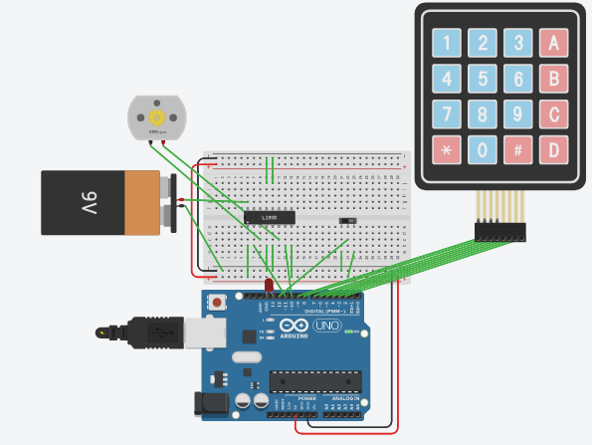
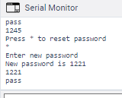
Simulation Results

Slide 9
Applications
It can be used in any vehicles.
It can be used to automate the ignition locking process, so that the user need not carry the ignition lock keys along with them. They just need to remember the password and use it to start their vehicle.
References:
Page referred: https://www.circuitbasics.com/how-to-set-up-a-keypad-on-an-arduino/
Simulation tool used: https://www.tinkercad.com/

Slide 10
Thank you

